Slide 1
Osher Lifelong Learning Institute, June 2026
Contemporary Economic Policy
University Of Minnesota
Host: Geoffrey Woglom, Director
National Economic Education Delegation

Slide 2
Course Schedule
Contemporary Economic Policy
  Week 1 (6/3): Economic Update & Changes at the Fed, Geoffrey Woglom, Amherst College
  Week 2 (6/10): Federal Debt and Deficits, Kathryn Wilson, Kent State University
  Week 3 (6/17): Banking Crises, Gerard Caprio, Williams College
  Week 4 (6/24): Saving Social Security, Geoffrey Woglom, Amherst College

Slide 3
Submitting Questions
I encourage questions. Please put questions in the chat and I will answer them periodically during the talk.
We will do a verbal Q&A once the material has been presented.
Slides are available from the NEED website https://needecon.org/delivered_presentations.php.

Slide 4
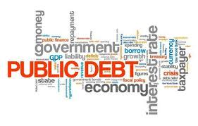
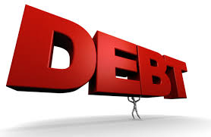
The US Federal Debt
June 10, 2026
Kathryn Wilson, Ph.D.
Kent State University

Slide 5
Credits and Disclaimer
This slide deck was created by:
  Jon Haveman, Executive Director, NEED
  Geoffrey Woglom, Amherst College, Emeritus
This slide deck was reviewed by:
  Olivier Blanchard, Brookings Institution
Disclaimer
  NEED presentations are designed to be nonpartisan.
  It is, however, inevitable that presenters will be asked for and offer their own views.
  Such views are those of the presenters and not necessarily those of the National Economic Education Delegation (NEED).

Slide 6
Outline
First: A Budget Overview
The Debt
Important Points About the Debt
Can’t Stop Thinking About Tomorrow
How to Think About the Debt
Summary

Slide 7
I. First: A Budget Review

Slide 8
What Does the US Govt. Budget Look Like?
2025 Budget Summary (in Trillions, % of GDP)
Revenue |  |  | Outlays
Income Taxes | $2.7 |  | Mandatory | $4.2
Payroll Taxes | $1.7 |  | Discretionary | $1.9
Corporate Taxes | $0.5 |  | Interest | $1.0
Other | $0.4
Total | $5.2 (17.3%) |  | Total | $7.0 (23.1%)
Budget Deficit: $1.8 Trillion (5.8%)
Source: https://www.cbo.gov/publication/60053
Notes:
https://www.cbo.gov/publication/53627
https://www.cbo.gov/publication/53624

Slide 9
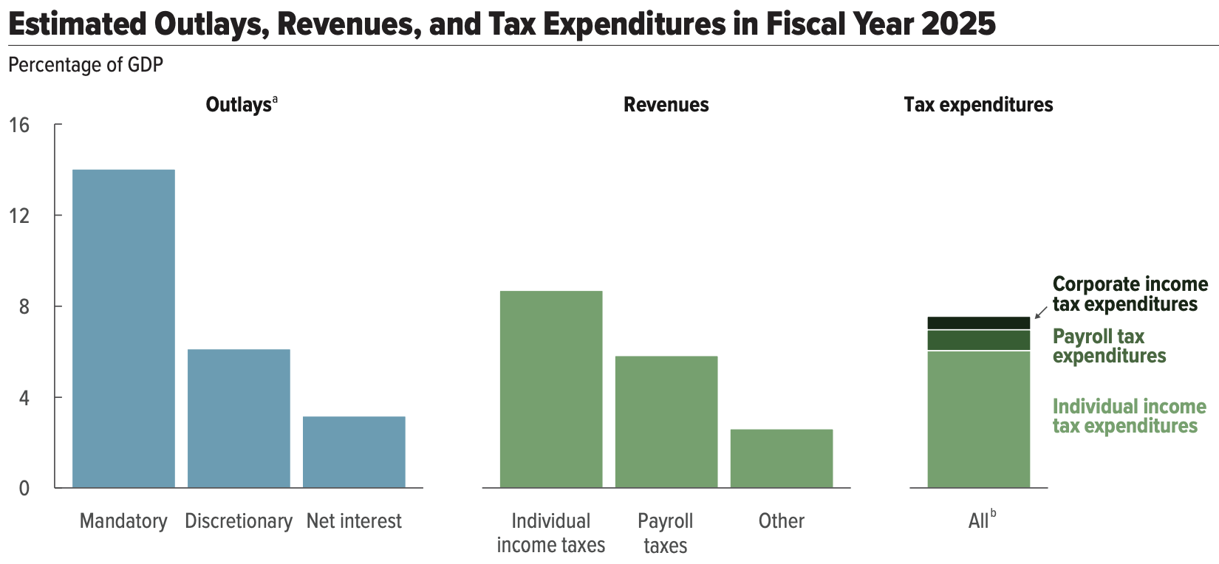
But There is More to The Budget!
Source: https://www.cbo.gov/system/files/2025-01/60870-Outlook-2025.pdf

Slide 10
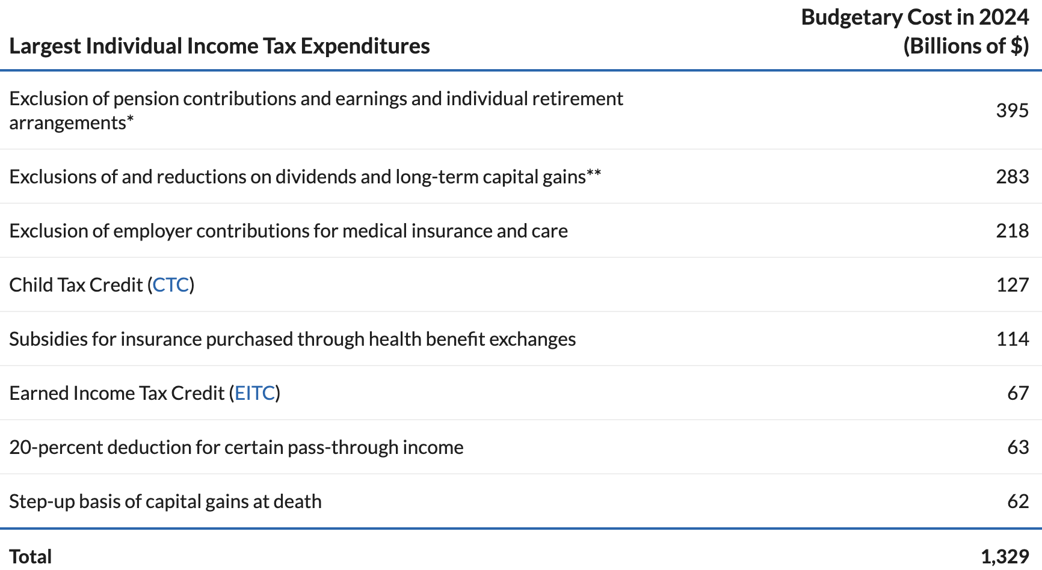
What Are Tax Expenditures?
Source: https://www.pgpf.org/article/chart-pack-individual-taxes/

Slide 11
II. And Now: The Debt

Slide 12
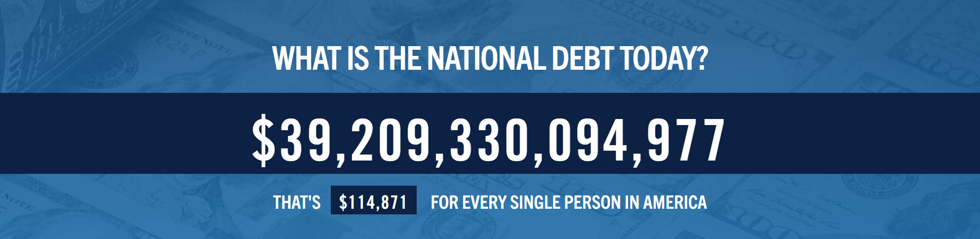
Source: https://www.pgpf.org/national-debt-clock/

Slide 13

Of Debt, Deficits, and Surpluses
FLOW
  Deficit: The excess of outlays over revenues in a year.
  Surplus: The excess of revenues over outlays in a year.
STOCK
  Debt: The accumulation of deficits over time.
      The sum of all past deficits and surpluses.
Deficit
Debt

Slide 14
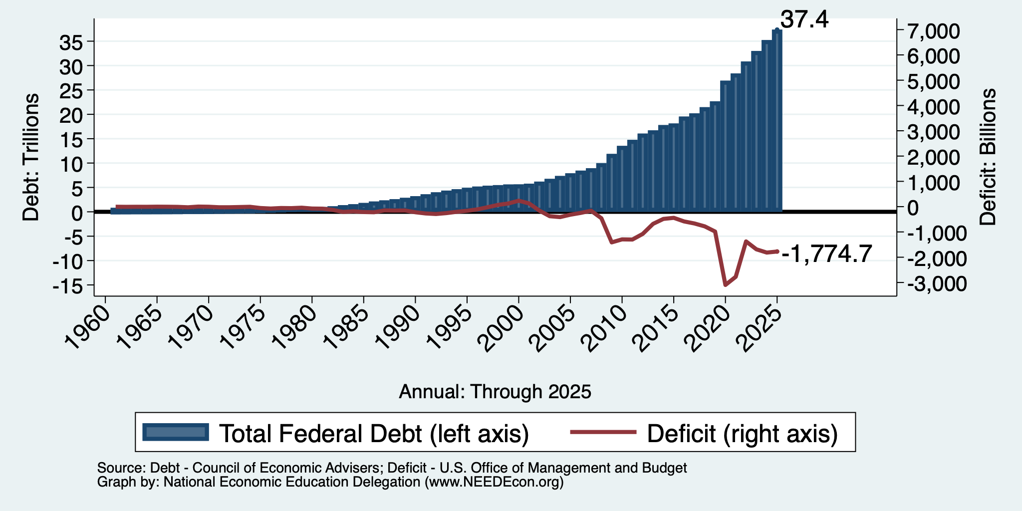
Debt vs. Deficit
Debt = The Sum of All Past Deficits Less Surpluses
Notes:
Debt2deficit.png

Slide 15
Major Takeaways: Talking Points
The debt is not currently a significant problem.
The current trajectory of federal debt is unsustainable.
We must enact plans to reduce future deficits.
  These are driven by Medicare and Social Security spending.
The longer we postpone action, the greater the probability of a “fiscal crisis.”

Slide 16
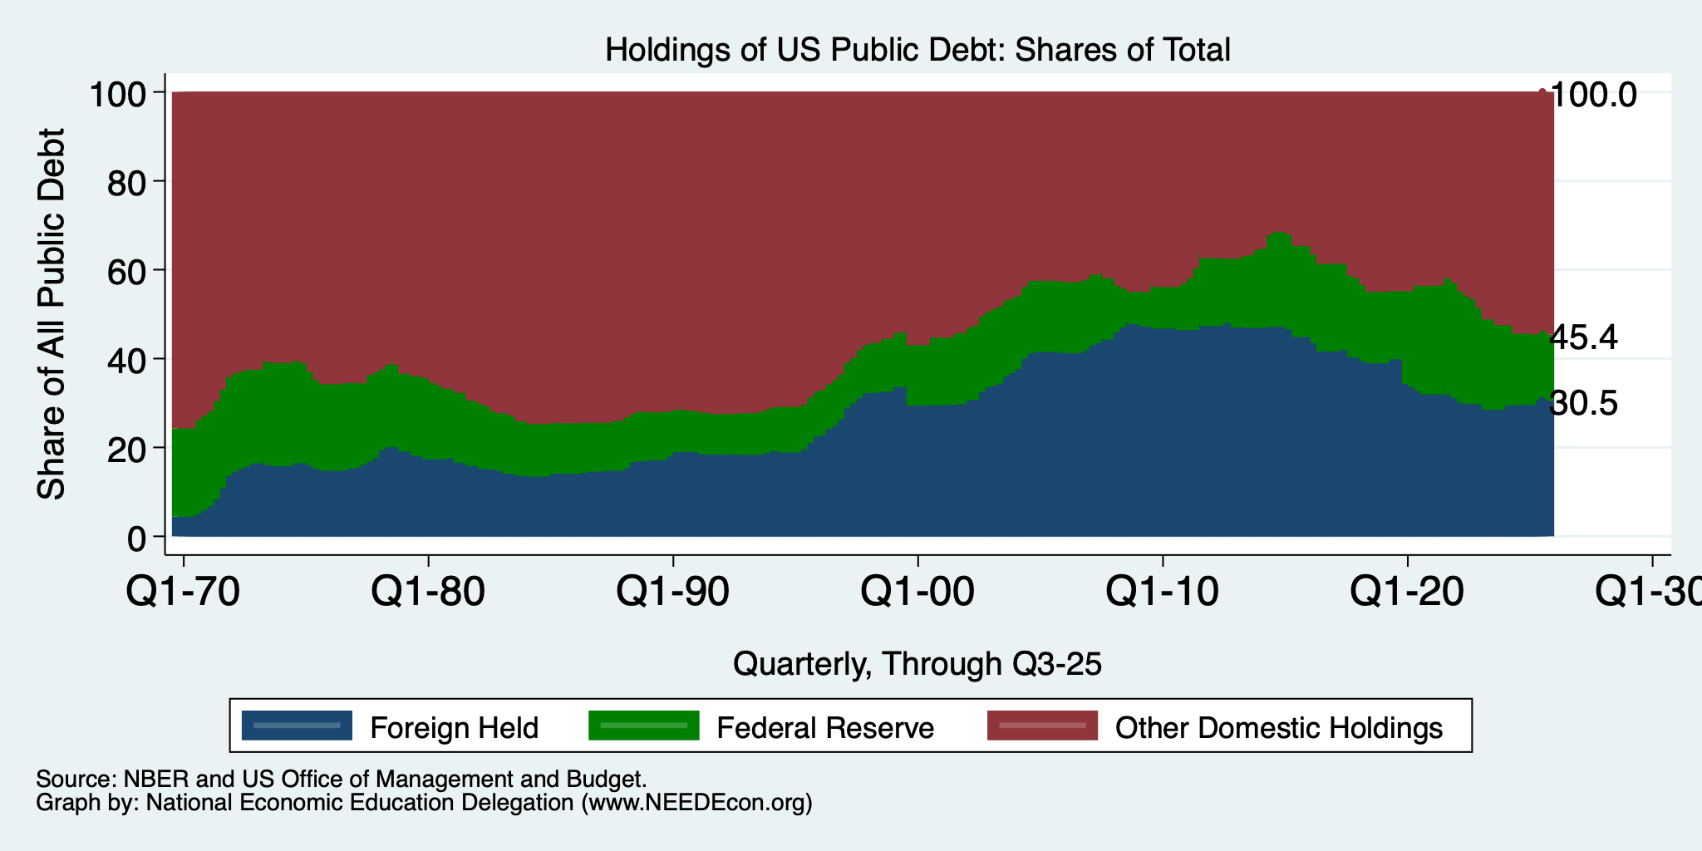
Trends in US Debt Holdings Over Time
2025, Q3: Other Domestic: 54.6%
Federal Reserve: 14.9%
Foreign: 30.5%
2025, Q2: Other Domestic: 52.9%
Federal Reserve: 15.6%
Foreign: 31.5%
2024, Q1: Other Domestic: 52.5%
Federal Reserve: 18.1%
Foreign: 29.4%

Slide 17
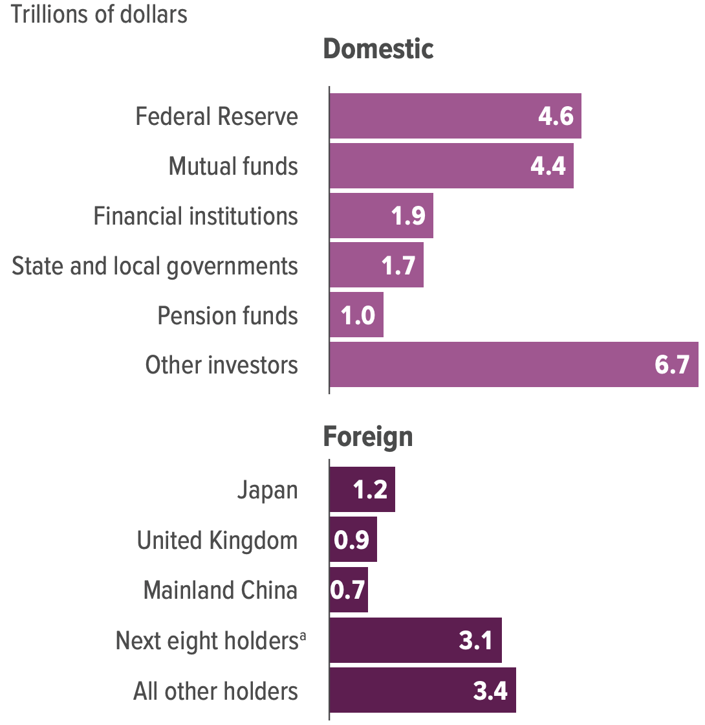
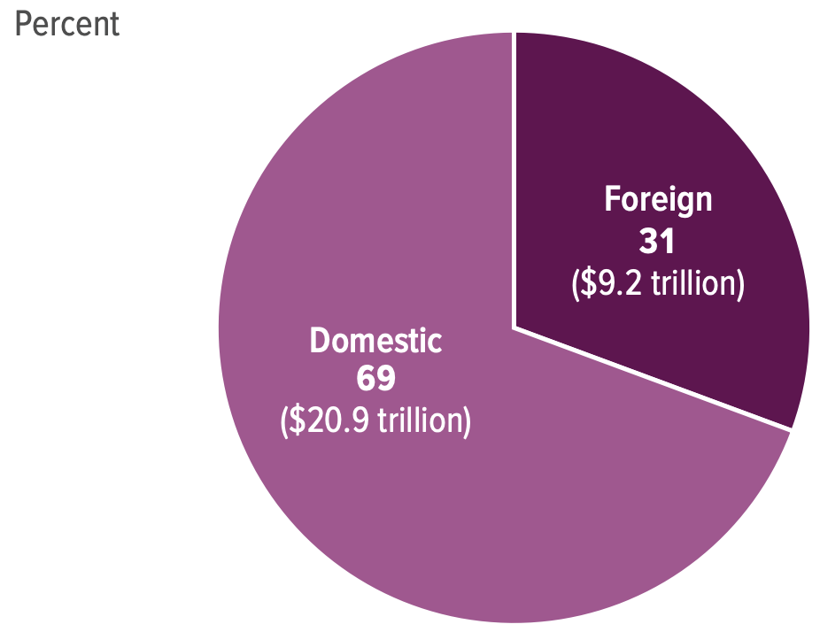
Holders of the Public Debt, 2025

Slide 18
Why Do Foreign Investors Buy US Treasuries?
Market for Treasuries is the deepest, most liquid capital market in the world.
The US economy has a history of political and economic stability.
The dollar is the largest international reserve currency.
  Most trade transactions (e.g., oil) are quoted in dollars.
  54% of international trade involves the dollar.
  88% of international transactions involve the dollar.
  With some exceptions, foreign governments borrow in dollars.

Slide 19
III. Important Points:
Not all debt is created equal.
What is the right measure of the debt?

Slide 20
Not All Debt Is Created Equal
Some debt can reduce the availability of investment funds to other borrowers.
  Often referred to as “crowding out” private investment.
IntRAgovernmental debt is (important) bookkeeping.
  This debt DOES NOT crowd out private investment.
Debt held by the public.
  This debt MIGHT crowd out private investment.
Most analyses of debt focus on federal debt held by the public.

Slide 21
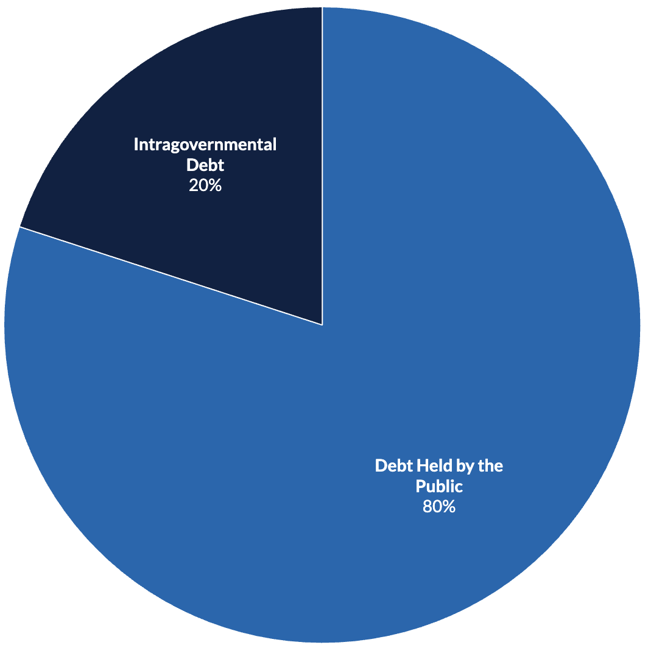
U.S. Publicly Held Debt, June, 2025
E.g., Social Security
and Medicare
Trust Funds
Source: PGPF.org

Slide 22
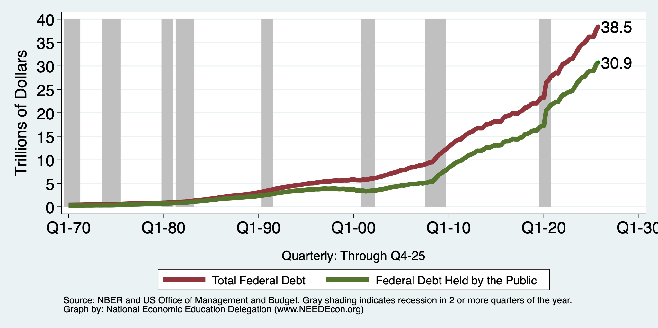
Two Measures of the Debt

Slide 23
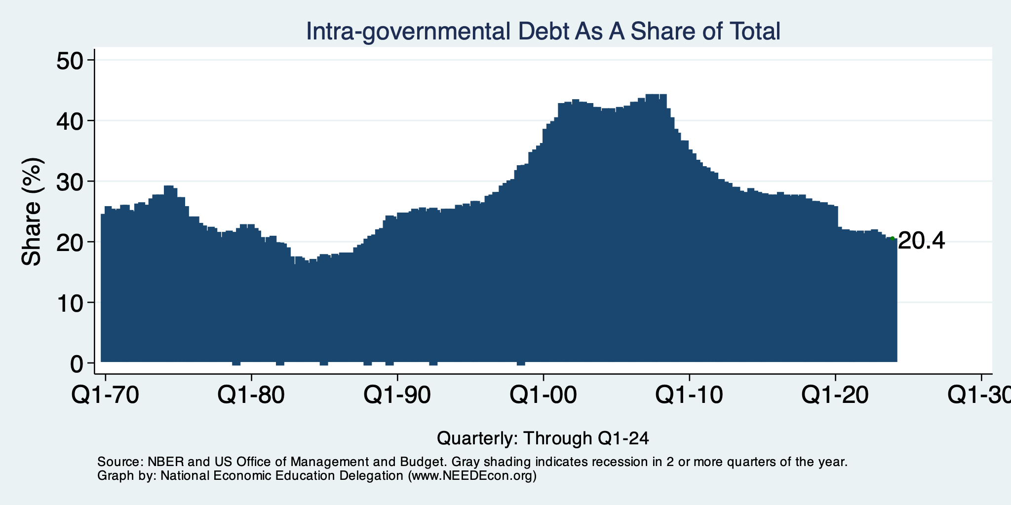
Trends in Intragovernmental Debt

Slide 24
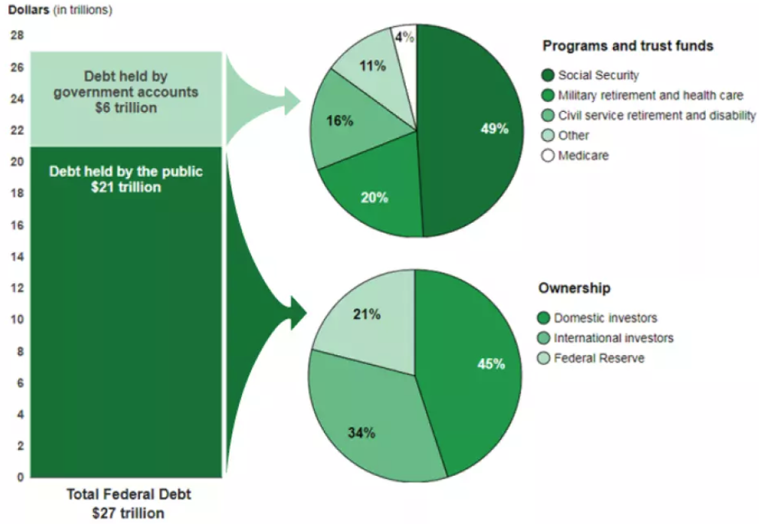
A Breakdown of Total Federal Debt, 2020
https://www.gao.gov/americas_fiscal_future?t=federal_debt

Slide 25
The All-Important Relative Debt
CBO analyzes the debt relative to GDP because:
  To the extent that debt and deficits have burdens, these burdens depend on the size of the debt relative to the size of the economy.
 | Total Public Debt | Relative Debt Debt/GDP
United States | $31.4 Trillion | 100%
Greece | $0.215 Trillion | 170%

Slide 26
Relative Debt and Deficit
Notes:
Debt2deficit.png

Slide 27
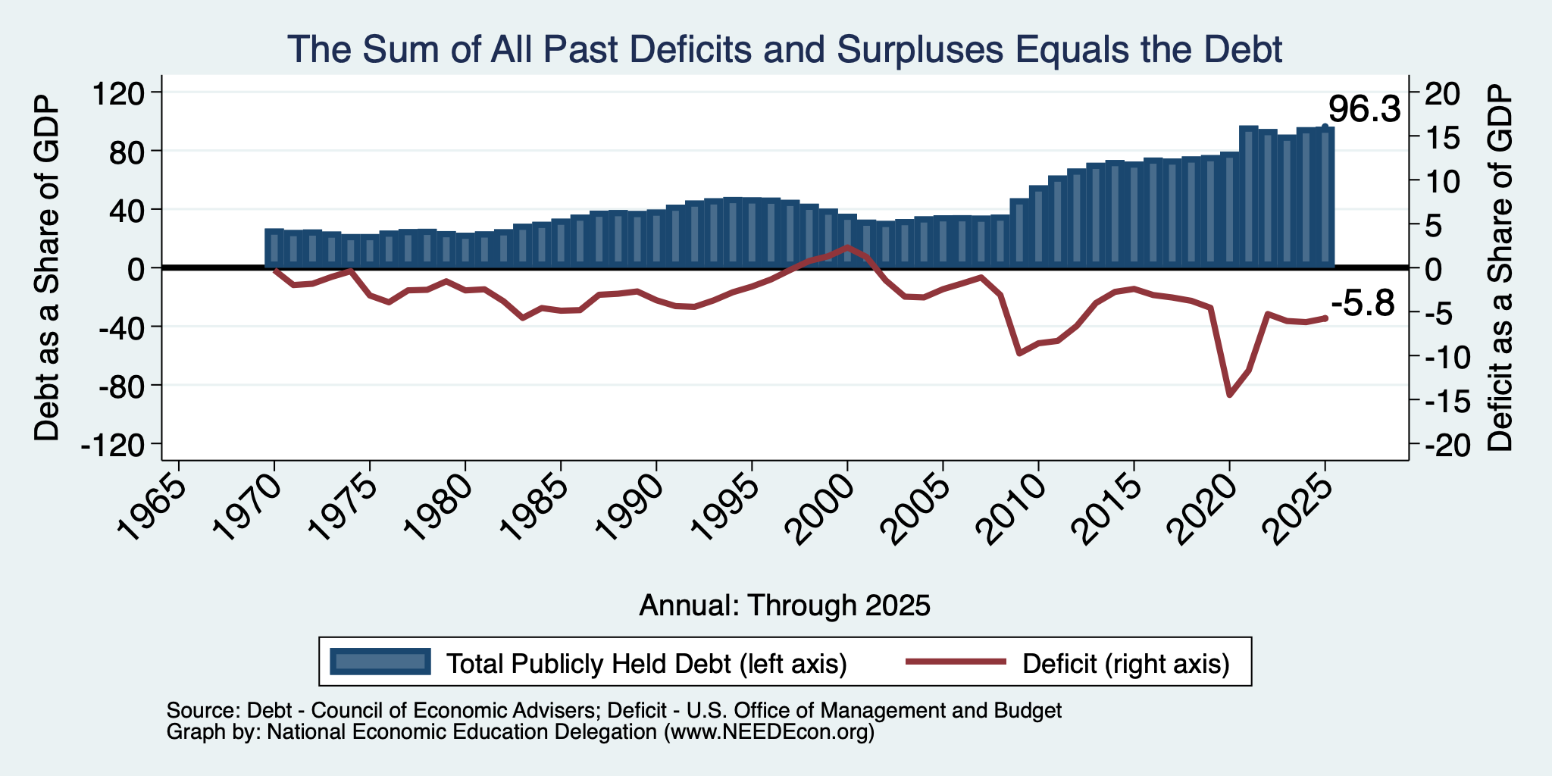
Relative Debt and Deficit
Notes:
Debt2deficit.png

Slide 28
Two Measures of the Deficit
(1) Primary deficit = current programmatic outlays – revenues
(2) Total deficit = primary deficit + interest
Interest on the debt is
  The part of the total deficit that is due to past deficits.
This distinction becomes important for understanding:
  The future course of relative debt.
  The costs borne by future generations because of the debt.

Slide 29
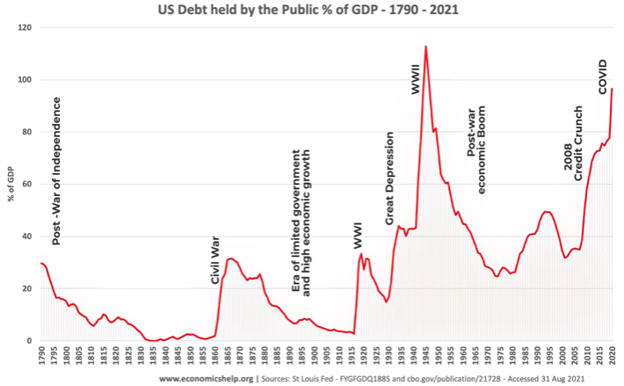
Key Points About US Relative Debt
1983
Relative debt peaked during World War II, followed by a long decline.
Prior to 1983, relative debt rose purposefully (wars and recessions) and then fell.
Relative debt has been and is expected to rise for the next 30 years w/o a strategic purpose.

Slide 30
Debt Dynamics
Surprising (?) Facts
  From 1945 to 1979, relative debt fell from 110% of GDP to 25% of GDP.
  During this period, the federal budget was in surplus only 8/35 years!
Relative debt is a fraction: Debt/GDP; fractions fall if:
  The numerator falls (budget surplus)
  The denominator rises (nominal GDP growth)
  The denominator grows faster than the numerator
    GDP growth is greater than the interest rate on borrowing.
    CAN still run deficits and reduce the relative debt.

Slide 31
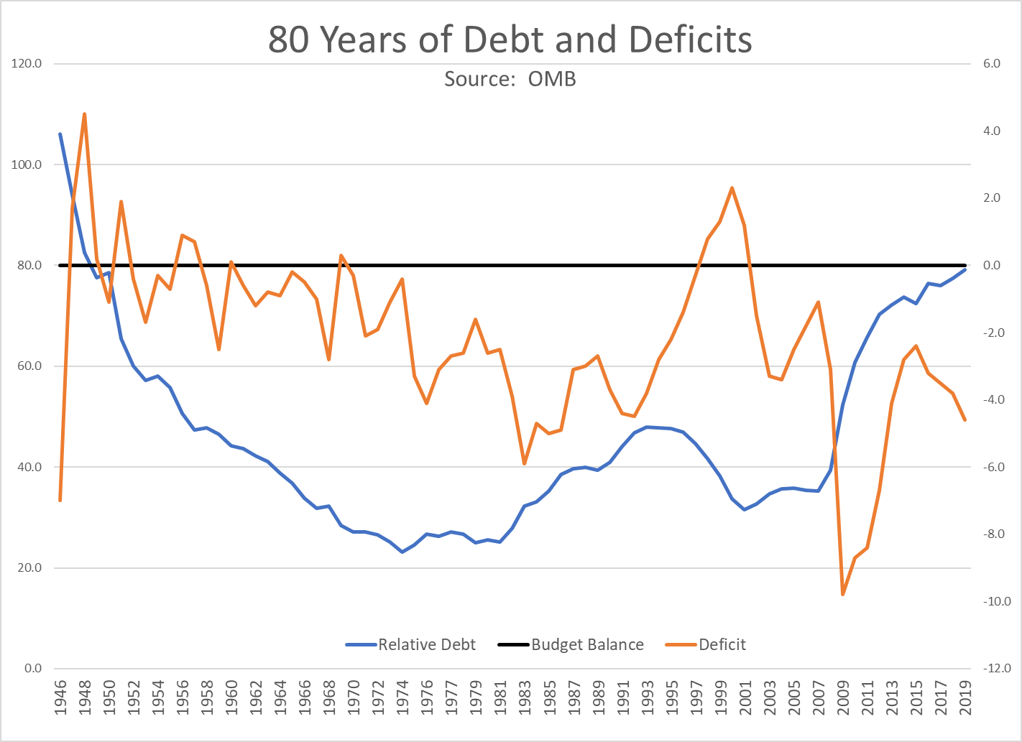
The Post-WWII Fall in Relative Debt

Slide 32
Debt Dynamics
Surprising (?) Facts
  From 1945 to 1979, relative debt fell from 110% of GDP to 25% of GDP.
  During this period, the federal budget was in surplus only 8/35 years!
Relative debt is a fraction: Debt/GDP; fractions fall if:
  The numerator falls (budget surplus)
  The denominator rises (nominal GDP growth)
  The denominator grows faster than the numerator
    GDP growth is greater than the interest rate on borrowing.
    CAN still run deficits and reduce the relative debt.

Slide 33
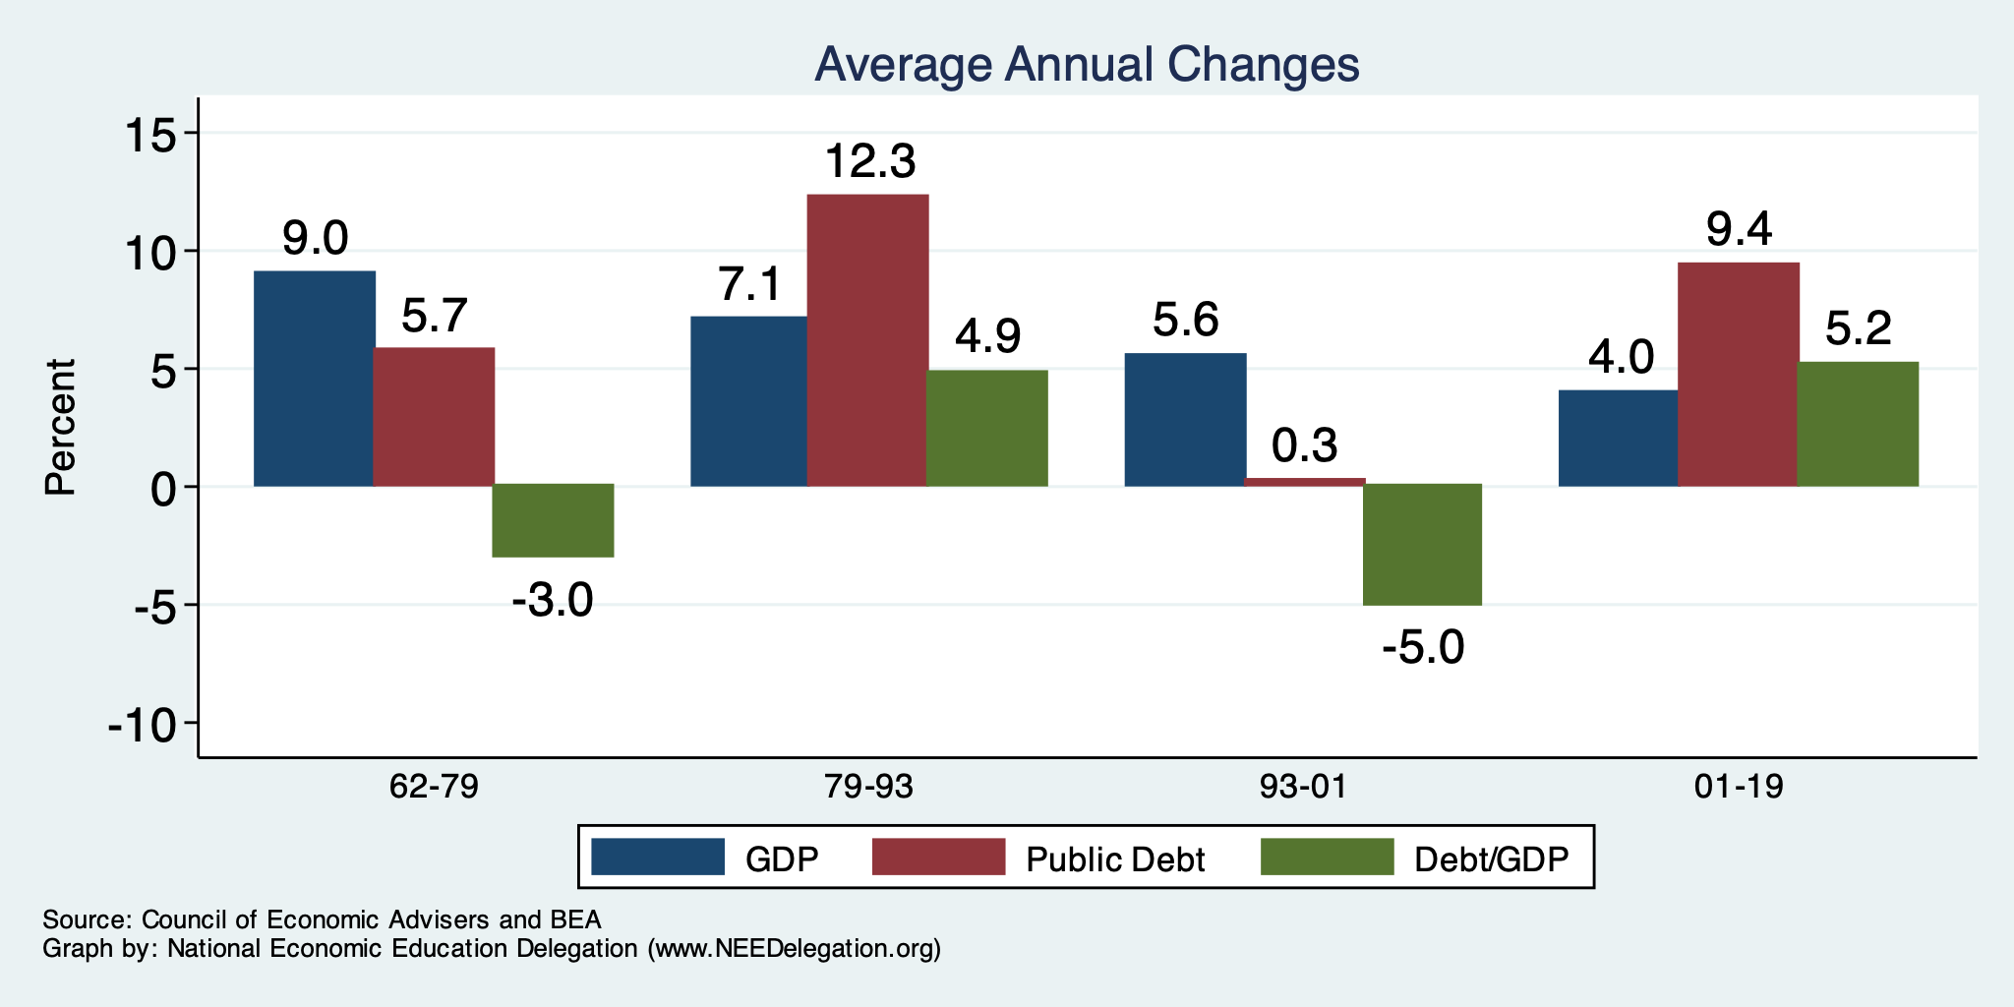
The Arithmetic of Changes in Relative Debt

Slide 34
An Almost Free Lunch
If the interest rate is less than the growth rate of GDP, then the contribution from the primary budget can be positive, hence…
Debt to GDP can be stabilized with a (small) primary deficit.

Slide 35
Is Stabilizing Relative Debt Good Enough?
This means that the absolute level of the debt would continue to increase.
Yes, it probably is good enough.
  It is a reflection of the economy’s ability to support the debt.
  Stability will avoid bond market scares.

Slide 36
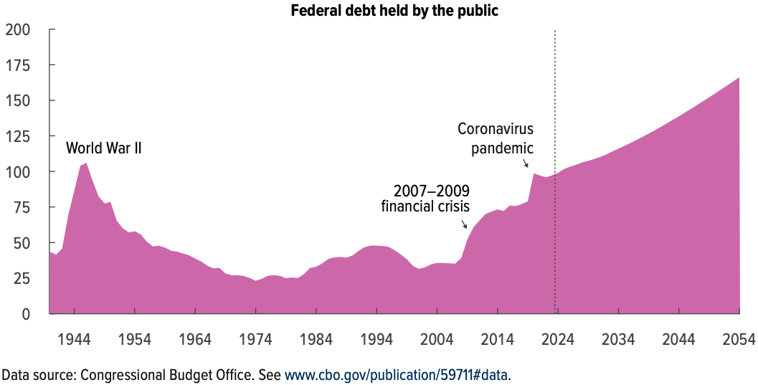
But Let’s Think About Today
Percent of GDP

Slide 37
Why Has the Federal Debt Risen So Much?
Expenditures UP:
  Social Security
  Health-care costs
  Economic stimulus
    In particular, during the Great Recession & COVID.
  Military engagements overseas
Revenues DOWN:
  Declining income tax revenues
    Stagnant wages
    Tax cuts
  Social security
    Declining revenues

Slide 38
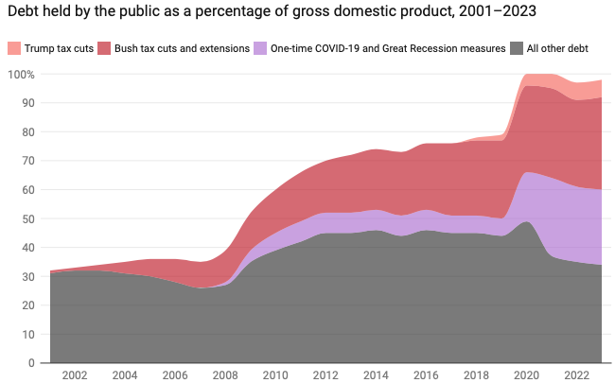
Tax Cuts Have Driven The Debt Increases
Trump Tax Cuts: 6% of GDP
Bush Tax Cuts: 32% of GDP
Great Recession & COVID: 26% of GDP
The rest: 34% of GDP
Up from 31% in 2001

Slide 39
Thinking About Today….
Do we have:
  A spending problem?
  A revenue problem?
  Both?

Slide 40
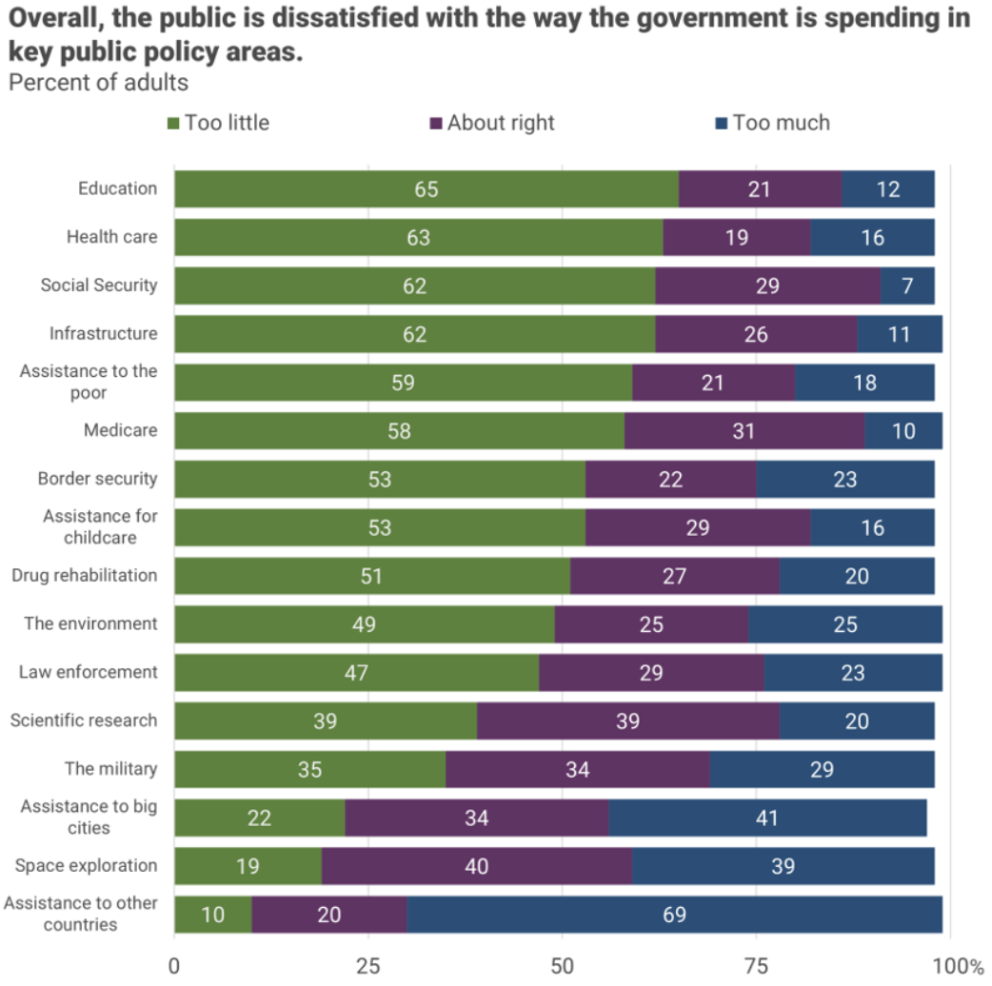
There is very little
enthusiasm for
cutting anything.
Source, NYTimes, Paul Krugman, “Why We Should, but Won’t, Reduce the Budget Deficit”

Slide 41
Thinking About Today….
Do we have:
  A spending problem?
  A revenue problem?
  Both?
Not much support for it being a spending problem.

Slide 42
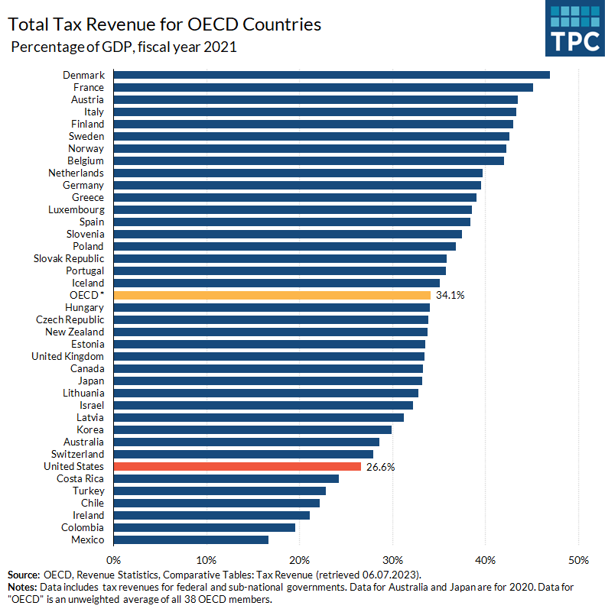
Source, Tax Policy Center https://www.taxpolicycenter.org/fiscal-fact/tax-revenue-share-gdp-oecd-countries

Slide 43
How To Address the Debt?
The question isn’t taxes vs spending cuts.
The question is:
  Who should bear the burden of solving the problem?
    Spending cuts will mean primarily lower-income households.
    Tax increases will mean primarily high-income households.
    Soc Sec benefit cuts (age limit, actual payments, etc.) will mean primarily lower-income households.

Slide 44
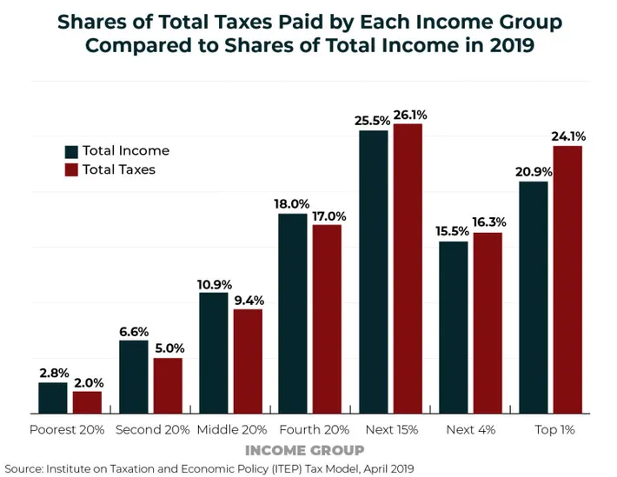
What? It’s not 40%? No, it’s 24.1%.
The 400 highest income households:
Paid an average tax rate of 8%.
https://nymag.com/intelligencer/article/fact-check-richest-1-dont-pay-40-of-the-taxes.html

Slide 45
IV. Can’t Stop…Thinking About Tomorrow

Slide 46
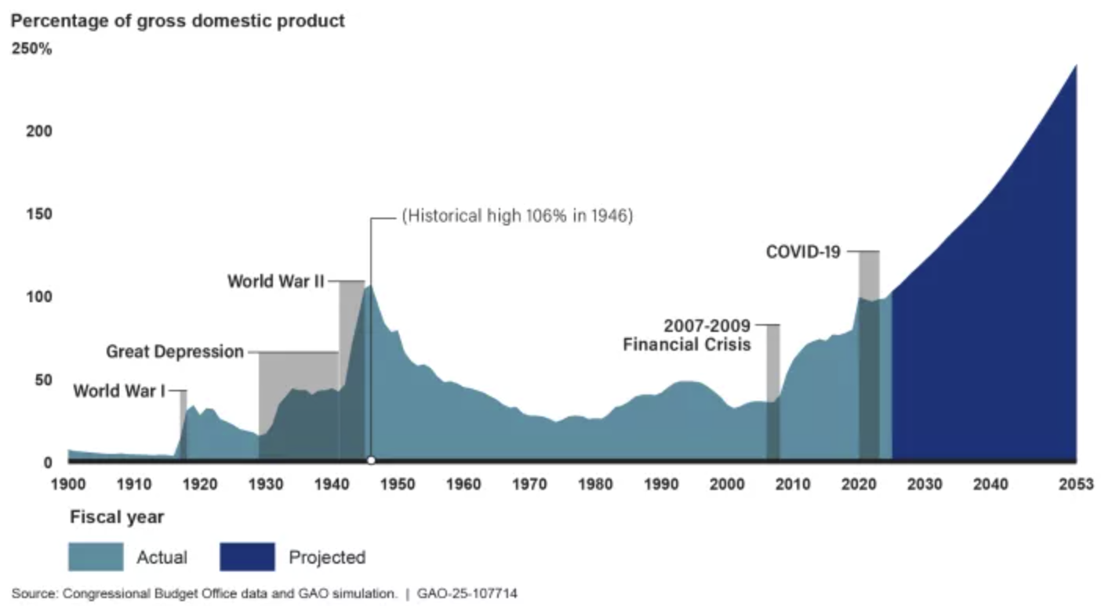
Now Let’s Think About Today and the Future
The Future

Slide 47
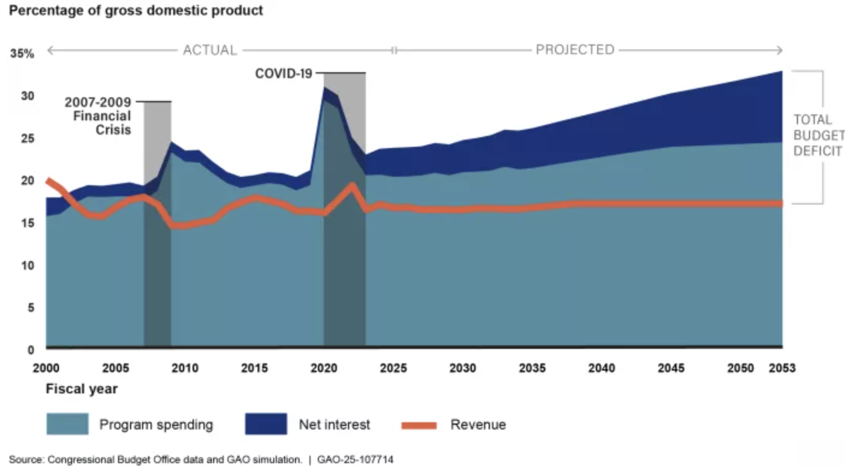
Interest on the Debt is a Growing Problem!

Slide 48
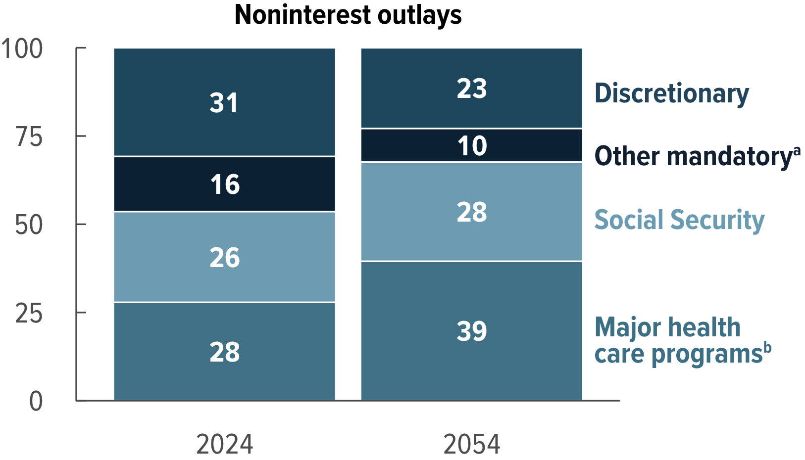
What Are the Primary Drivers Going Forward?
Social Security
And Medicare
Source: CBO 2024 Long Term Budget Outlook

Slide 49
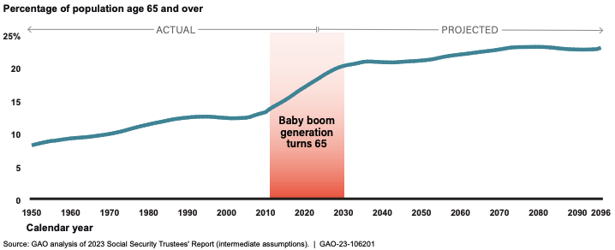
The Population is Aging

Slide 50
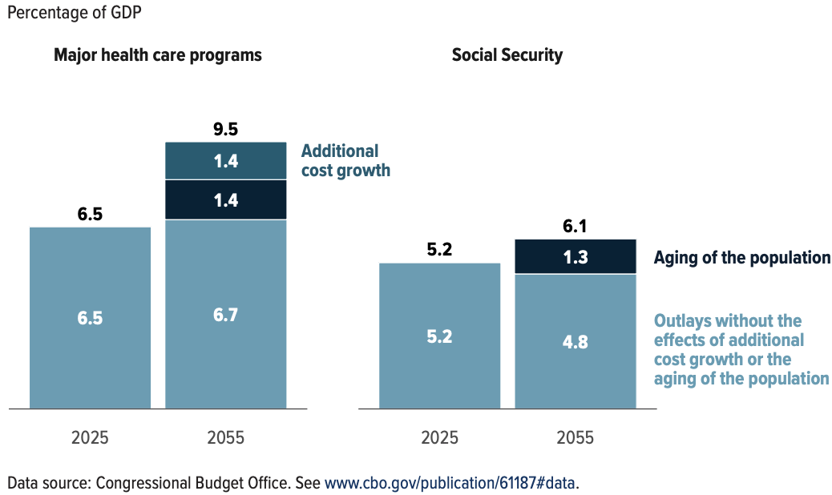
Mostly Healthcare

Slide 51
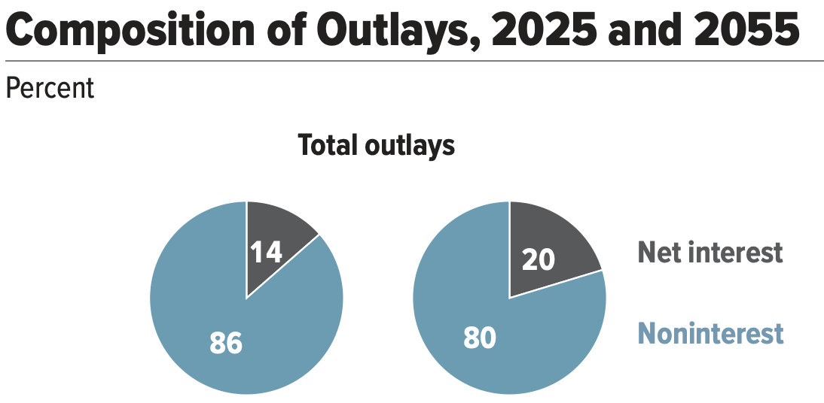
And Then There is Interest on the Debt

Slide 52
V. How to Think About the Debt

Slide 53
Perspectives on Increased Debt
Does debt impose a burden on future generations?
  Does it inevitably have to be paid off? No!
Government borrowing crowds out private capital and investments.
  Weakened by the ability to borrow from other countries.
In time, debt service might crowd out other government spending.
  Diminishing policy priorities in the budget.
Is it reasonable to borrow at low interest rates for investment?
  For example, for infrastructure.

Slide 54
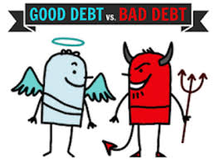
Not All Borrowing Is Bad!
Two good reasons to borrow:
  During a temporary crisis
    Recession
    War
    Pandemic
  Productive public investment
    Infrastructure
    Education
These deficits did not and do not permanently increase relative debt.
  Great Depression, WWII, Great Recession, COVID
  Public investment expands GDP and tax revenue

Slide 55
Is The Debt a Problem Today?
Federal government borrows each month with little difficulty.
Very little evidence of ”crowding out.”
Interest rates had been low the past decade, but higher now (but coming down) – this is becoming a concern.
So, no, it’s not a problem today.

Slide 56
So, Why Worry About it?
If debt becomes too high:
  Investors might start questioning the creditworthiness of the US government.
    Problem: Nobody knows how high is too high.
  It becomes more difficult to borrow in times of crisis.
    War, severe recession
    “Fiscal space”
      Impossible to measure how much we have.
      Clearly, we have less now than in 2007.
  Could start to crowd out investment by consumers and businesses.
    Not currently a problem. No idea if/when it might become one.
  Could be inflationary.

Slide 57
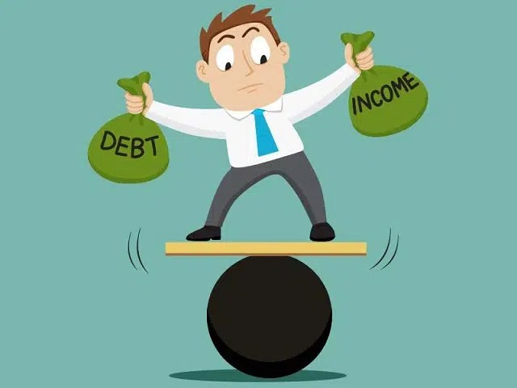
So, Why Worry About It?
If debt continues to grow:
  Interest payments will grow with it.
    14% of spending in 2025.
    20% of spending in 2055.
    Less room for using the budget for policy priorities.
    30% of payments go to other countries.
  The longer we wait to address it, the harder and more disruptive addressing it will be.

Slide 58
Growth in Relative Debt
Can be scary to….
  International investors
  Bond markets

Slide 59
Fiscal Crisis, or a Run on the Dollar
With an exploding relative debt, what happens if foreigners lose confidence in the stability of the dollar?
CBO (Federal Debt: A Primer, March 2020):
  because the United States currently benefits from the dollar’s position as the world’s reserve currency and because the federal government borrows in dollars, a financial crisis—similar to those that befell Argentina, Greece, or Ireland—is less likely in the United States.
Although no one can predict whether or when a fiscal crisis might occur or how it would unfold, the risk is almost certainly increased by high and rising federal debt.
Crises of confidence, in addition to being unpredictable, happen very quickly.

Slide 60
What Is a Fiscal Crisis?
Increased perception of risk in government debt.
Potential manifestations:
  Sudden significant increase in interest rates
  Plunging exchange rates
Why?
  Increased expectation of default
Potential results:
  Dramatic budget reforms may be quickly necessary to stave off actual default.
  Recession from declines in:
    investment (interest rates)
    consumption (interest rates)
    Government spending
  Higher interest bill on existing debt

Slide 61
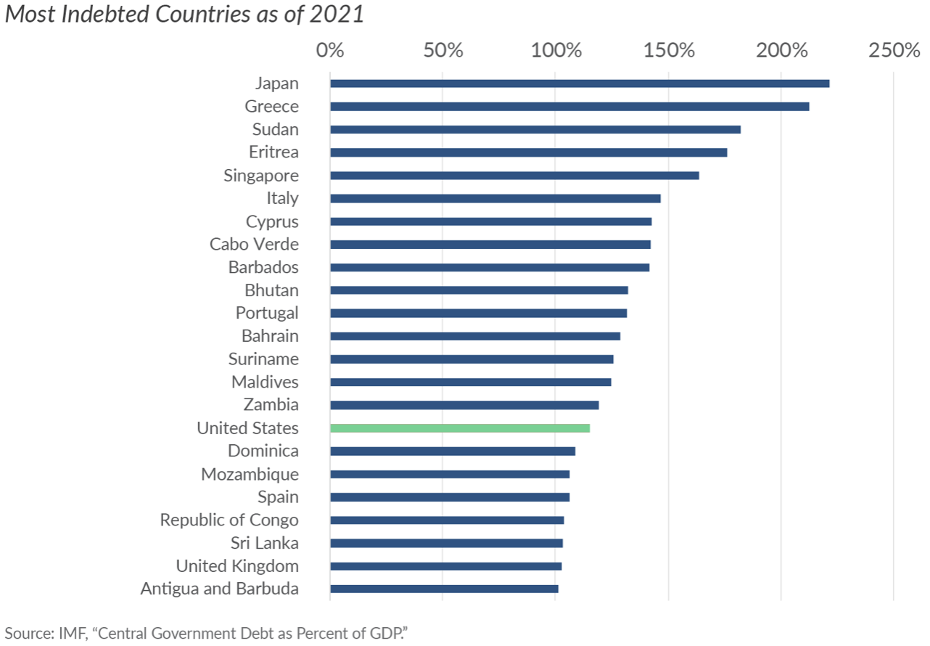
Other Countries Have Higher Debt Levels
Source: https://taxfoundation.org/blog/us-debt-compares-to-other-countries/

Slide 62
VI. Summary

Slide 63
Major Takeaways: Talking Points
The debt is not currently a significant problem.
The current trajectory for the federal debt is unsustainable.
  The primary drivers are an aging population, healthcare costs and interest.
We must enact plans to reduce the future (primary) deficits.
  These are driven by Medicare and Social Security spending.
The longer we postpone action, the greater the probability of a “fiscal crisis.”

Slide 64
Bottom-Line Takeaways
High debt levels should not deter:
  Productive infrastructure investment.
  Fiscal responses to crises:
    “When the house is on fire, you don’t worry about being in a drought; you just put it out.”
      Great recession – the house was on fire.
      COVID – the house was on fire.

Slide 65
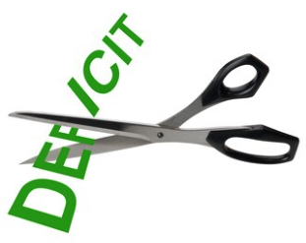
Bottom Bottom Line
Question is not WHETHER the US will have to act…
but WHEN.
Some combination of the following WILL be necessary:
  Raising taxes
  Cutting spending
  Reining in health-care costs
The longer we wait, the harder it will be!

Slide 66
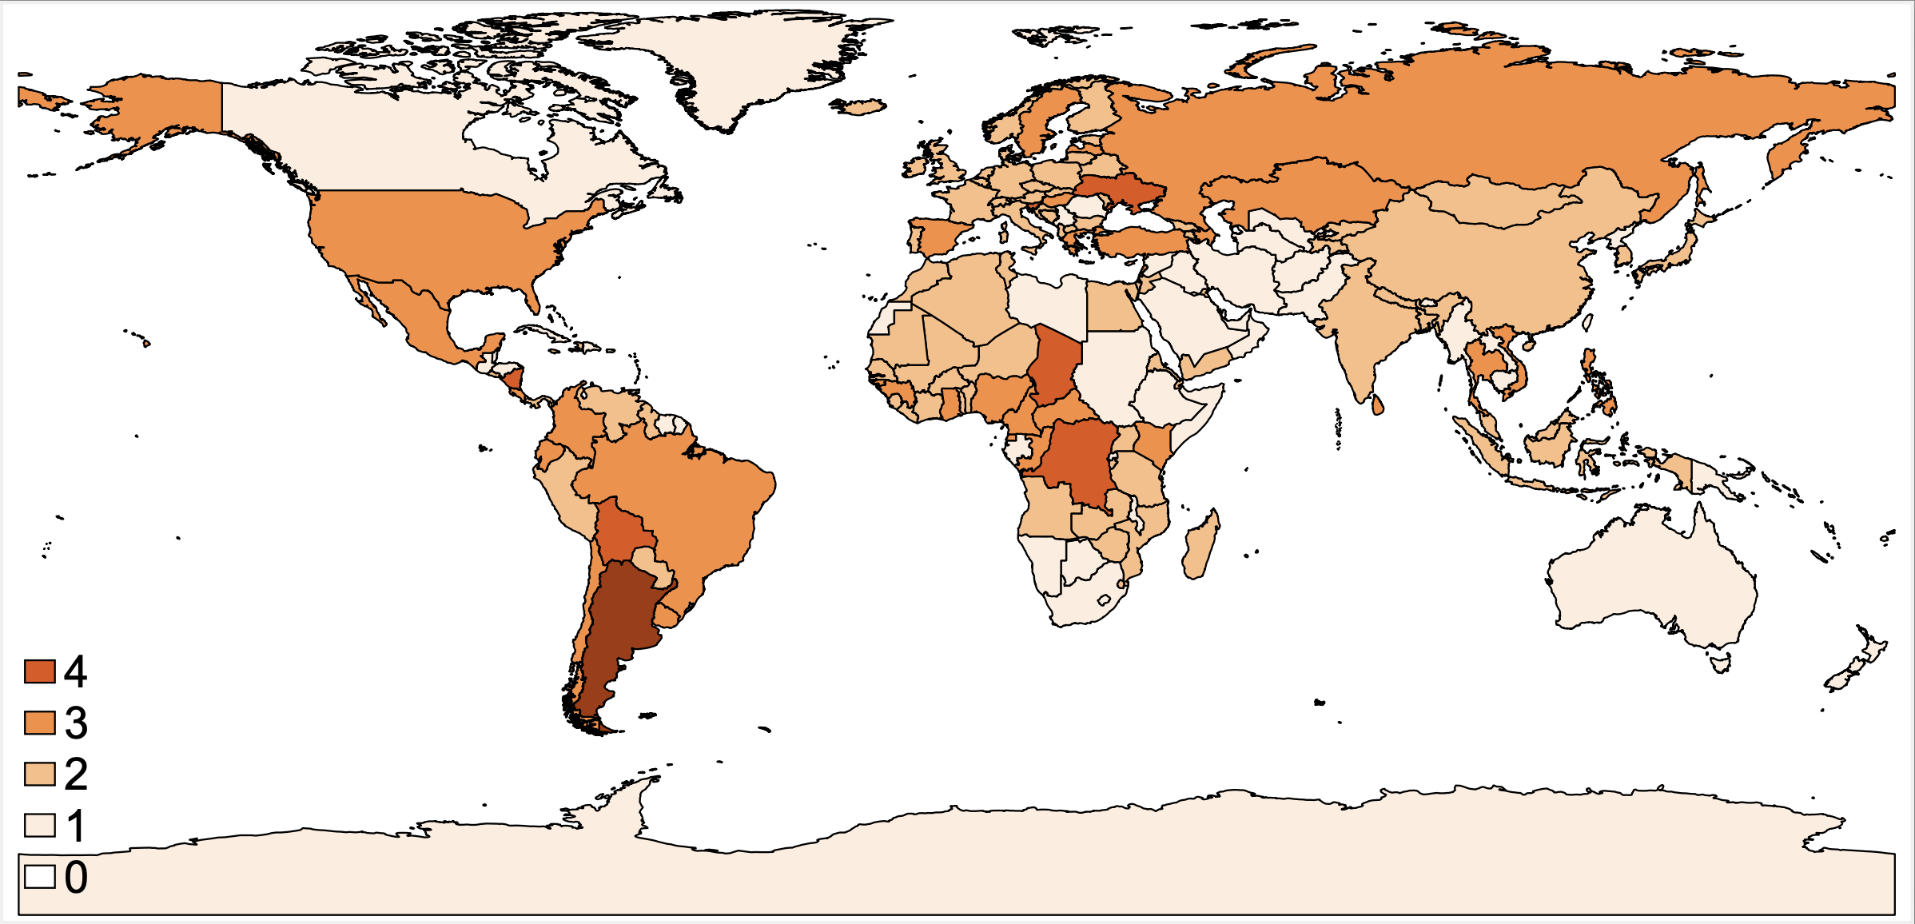
Next Week: Frequency of Systemic Crises, 1970-2024
Notes:
Laeven and Valencia, forthcoming

Slide 67
Thank you!
Any Questions?
www.NEEDEcon.org
Kathryn Wilson, Ph.D.
kwilson3@kent.edu
Contact NEED: info@NEEDEcon.org
Submit a testimonial: www.NEEDEcon.org/testimonials.php
Become a Friend of NEED: www.NEEDEcon.org/friend.php

